Slide 1
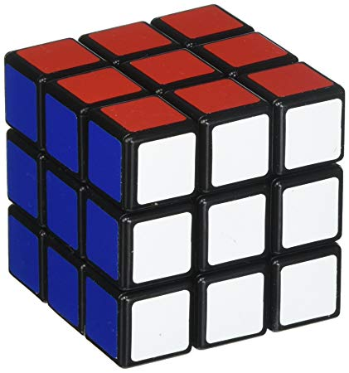
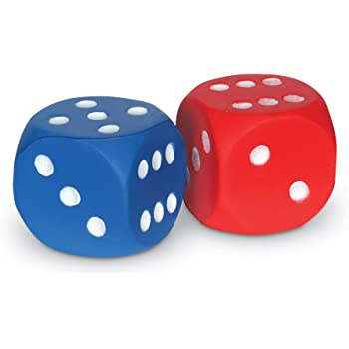
Cubes & Dice

Slide 2
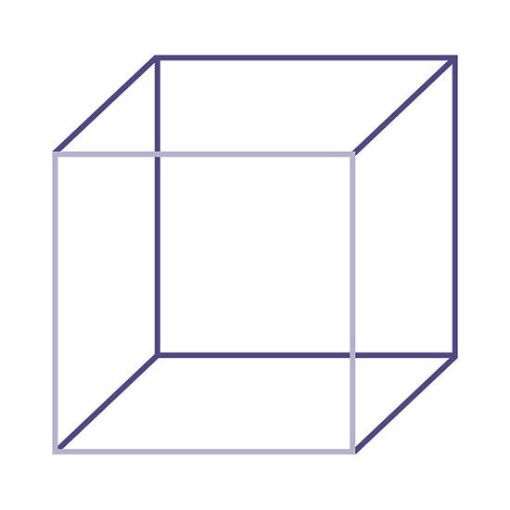
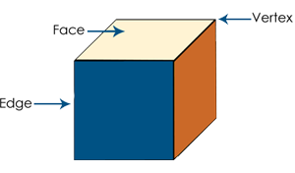
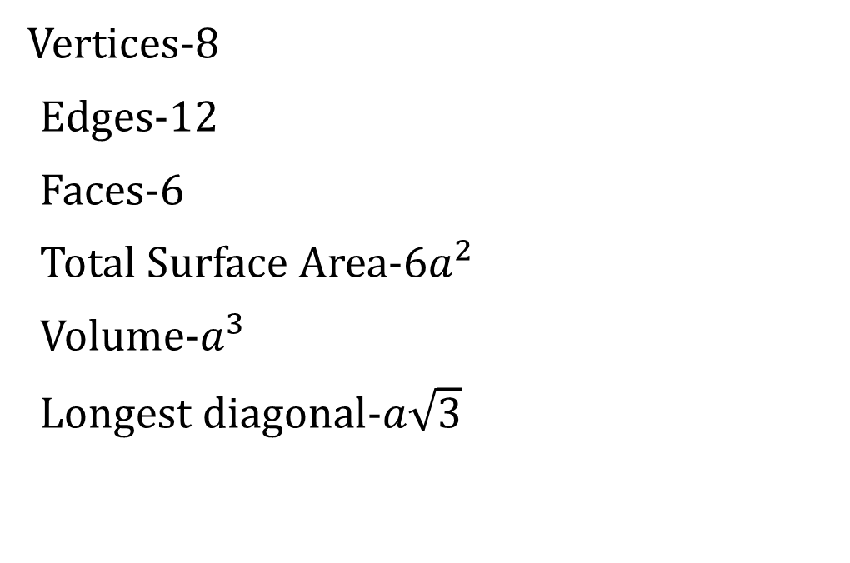
Basic Features
Vertices-8
Edges-12
Faces-6
Total Surface Area-6$a^{2}$
Volume-$a^{3}$
Longest diagonal-$a\sqrt{3}$

Slide 3
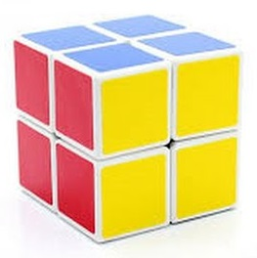
To find the Max number Identical Pieces, number cuts given
N cuts in the same axis, N+1 pieces.
Example 1
Given 3 cuts, find the max number of identical pieces?
X Y Z
1 + 1 + 1 = 3 cuts
2 × 2 × 2 = 8 pieces.
Logic: Find the close multiple of 3, distribute equally or almost equally in all three axis and add 1 each and then multiply.
Note: Minimum number of identical pieces is 3+1=4 pieces.

Slide 4
To find the Max number of Pieces
Example 2
What is the maximum number of identical pieces using 13 cuts?
X Y Z
4 + 4 + 5 = 13 cuts
5 × 5 × 6 = 150 pieces.

Slide 5
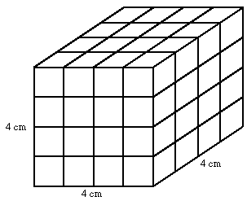
To find the Minimum number of cuts, number of identical pieces is given
Example 3
A big cube is divided into 64 identical small cubes, find the minimum number of cuts to do so?
X Y Z
3 + 3 + 3 = 9 cuts
4 × 4 × 4 = 64 pieces.
Logic: Find the three factors of the given number which are very close to each other, subtract one from each and then add.
Note: The max number of cuts is 64-1=63.

Slide 6
To find the min number of cuts
Example 4
Find the minimum number of cuts for 100 identical pieces from a big cube?
X Y Z
4 + 4 + 3 = 11 cuts.
5 × 5 × 4 = 100 pieces

Slide 7
Naming a Cube
Odd Series Even Series
1 × 1 × 1 2 × 2 × 2
3 × 3 × 3 4 × 4 × 4
5 × 5 × 5 6 × 6 × 6 etc..

Slide 8
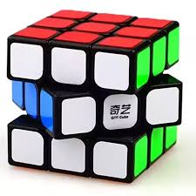
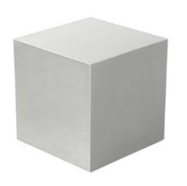
Covering a Cube
Example 5
How many small cubes of the same size are required to cover 1 small cube completely?
Inside 3×3×3, it is 1×1×1.
Therefore 27 – 1 = 26 small cubes.

Slide 9
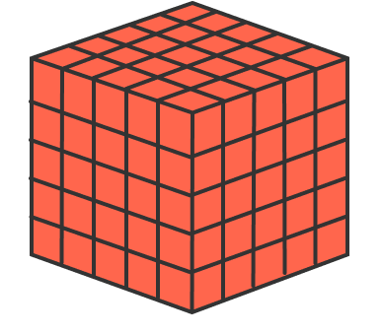
Painting a cube
Example 6
A big cube is painted orange in colour, and it is divided in to 125 identical pieces. Find how many smaller cubes have
(i) 3 faces painted (ii) 2 faces painted
(iii) 1 face painted (iv) 0 face painted.
Corners - 8
Edges - 12×3 = 36
Faces - 6×9 = 54
Hidden - 3×3×3 = 27

Slide 10
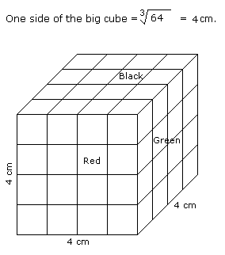
Painting a cube
Example 7
All the opposite faces of a big cube are colored with red, black and green colors. After that is cut into 64 small equal cubes.
How many small cubes are there where one face is green and other one is either black or red ?
Answer: 2 x 4 x 2 = 16

Slide 11
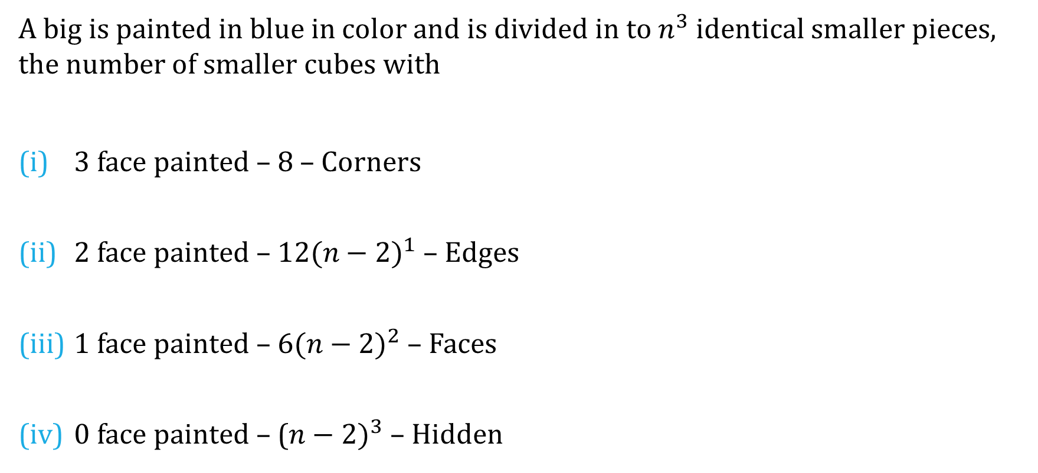
Formula – Painting a Cube
A big is painted in blue in color and is divided in to $n^{3}$ identical smaller pieces, the number of smaller cubes with
3 face painted – 8 – Corners
2 face painted – $12({n−2)}^{1}$ – Edges
1 face painted – $6({n−2)}^{2}$ – Faces
0 face painted – (${n−2)}^{3}$ – Hidden

Slide 12
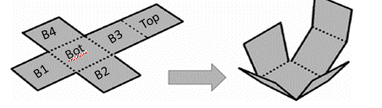
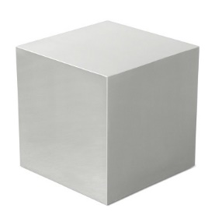
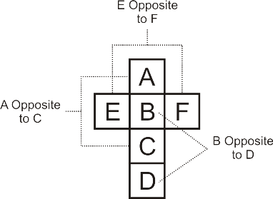
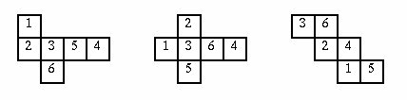
Dice Deconstruction

Slide 13
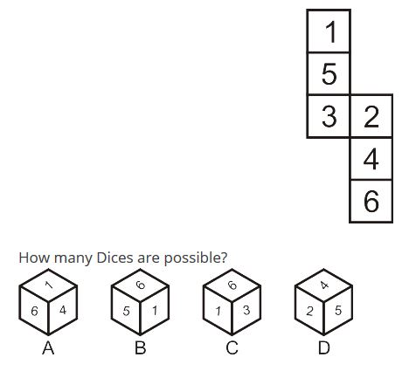
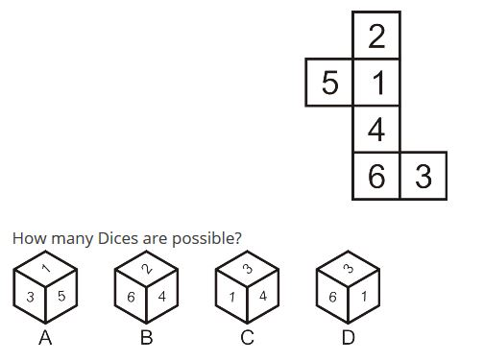
Examples 8-9
Ans: Only C is possible
Ans: A & B possible

Slide 14
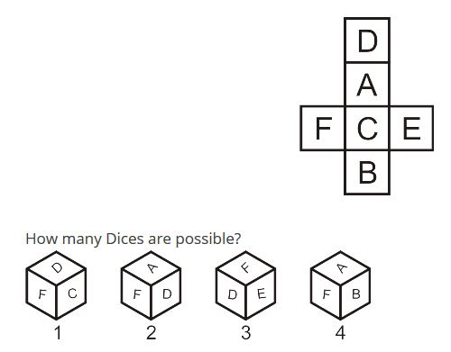
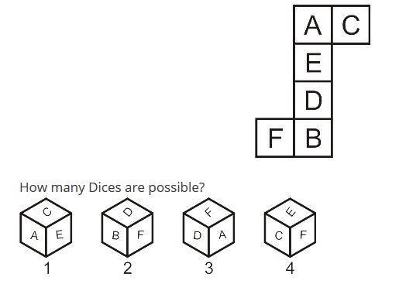
Examples 9-10
Ans: Only 2 is possible
Ans: 1 & 2 possible

Slide 15
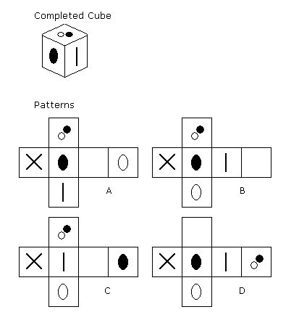
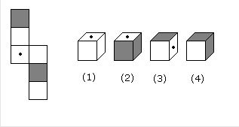
Example 11&12
Ans: 1, 3 & 4 are possible
Ans: B

Slide 16
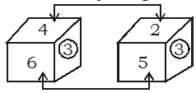

Closed Dice Rules
Case I - If one face is common
3 6 4
↓ ↓ ↓
1 5 2
Case II - If two faces are common
1
↓
6
Note: For other two cases, many possibilities.

Slide 17
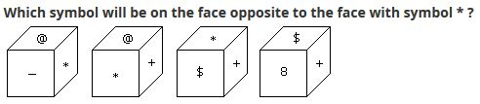
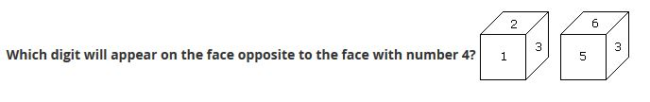
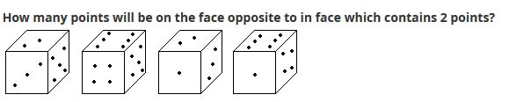
Examples 13-15
Ans: 8
Ans: 3
Ans: 6

Slide 18

Thank You
Narayan

